Slide 1
API Engineering > setup openapi/swagger for interactive api test-bed and document generation
Step to add OPENAPI middleware into the existing web application
Add openapi lib to the project
In the terminal/command line, execute the following command
dotnet add package Swashbuckle.AspNetCore --version 5.6.3
2. In Startup.cs> ConfigureServices()
Add the following code to register for open api
services.AddSwaggerGen(c =>
{
c.ResolveConflictingActions (apiDescriptions => apiDescriptions.First ());
c.SwaggerDoc("v1", new OpenApiInfo { Title = "p1 api version1", Version = "v1" });
});
3. In Startup.cs> Configure()
Add the following code to register for open api
app.UseSwagger();
app.UseSwaggerUI(c => c.SwaggerEndpoint("/swagger/v1/swagger.json", "p1 api version1"));

Slide 2
API Engineering> API Annotation
Step to annotate OPENAPI tag in a controller
In a controller file, just above the class definition, add the following annotation
using Microsoft.AspNetCore.Mvc;
namespace l2.Controllers{
[Route("api/[controller]/[action]")]
public class Service1Controller: Controller{
[HttpPost]
public int add(int x, int y){
return x+y;
}//ef
}//ec
}//en

Slide 3
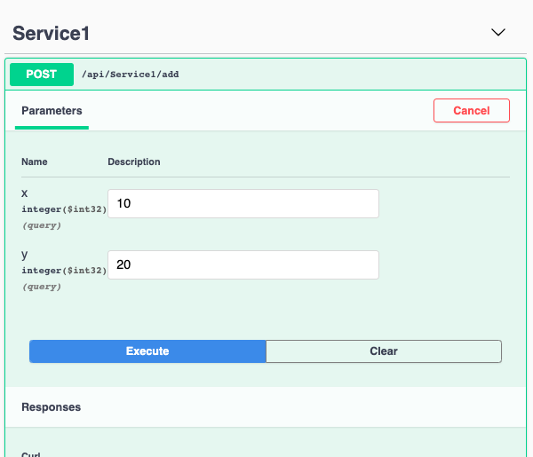
API Engineering > API test-bed
http://localhost:5000/swagger

Slide 4
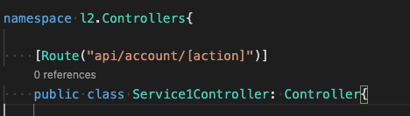


API Engineering > Controller data/ List of Objects
Id | Name | Pin | balance
1 | andy o | 1234 | 1000
2 | Kathy s | 8888 | 2000
//your business logic go here

Slide 5
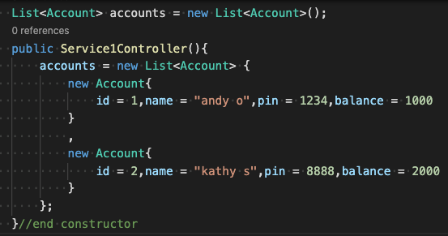


API Engineering > Use LinQ for data selection
Id | Name | Pin | balance
1 | andy o | 1234 | 1000
2 | Kathy s | 8888 | 2000
[
{"id": I, "name ": "andy o "}
,
{ "id": 2, "name": "kathy s"}
]

Slide 6


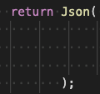


API Engineering > Object/Row Selection and Data return pattern

Slide 7
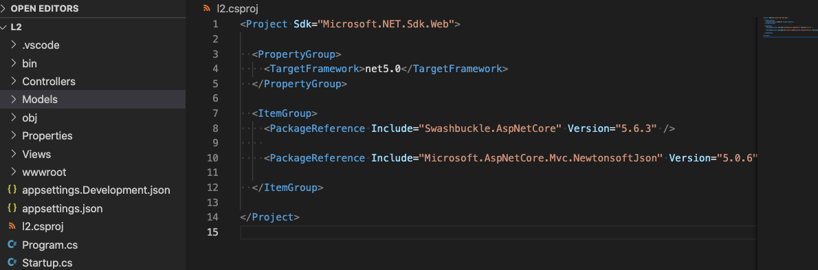
API Engineering > Nested Properties and JSON to Data Class automatic Conversion
1. Add Lib dependency in the project file

Slide 8
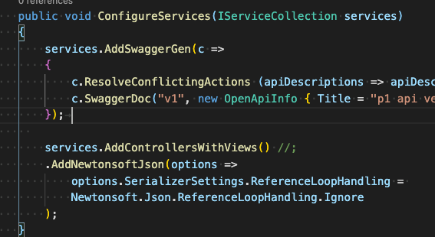
API Engineering > Nested Properties and JSON to Data Class automatic Conversion
2. Add newton service in startup.cs file

Slide 9
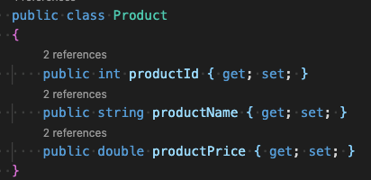
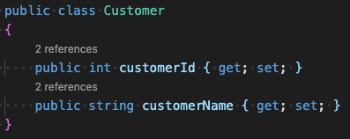
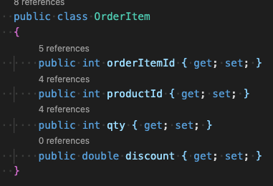
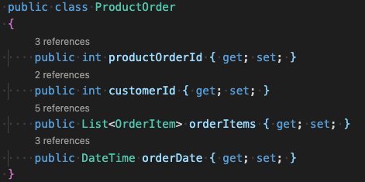
API Engineering > Nested Properties and JSON to Data Class automatic Conversion
3. Data Modeling (ref: WhiteBoard)

Slide 10
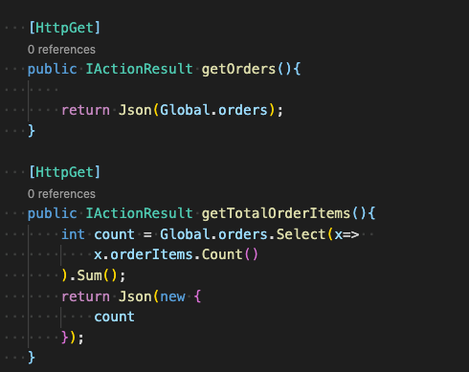
API Engineering > Nested Properties and JSON to Data Class automatic Conversion
4. Get Total Order Items

Slide 11
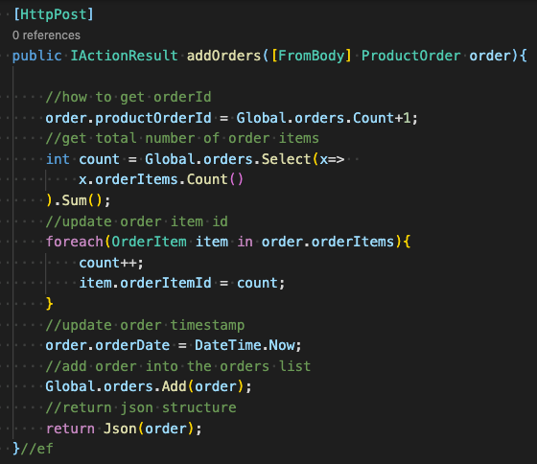
API Engineering > Nested Properties and JSON to Data Class automatic Conversion
5. Add Order

